Slide 1
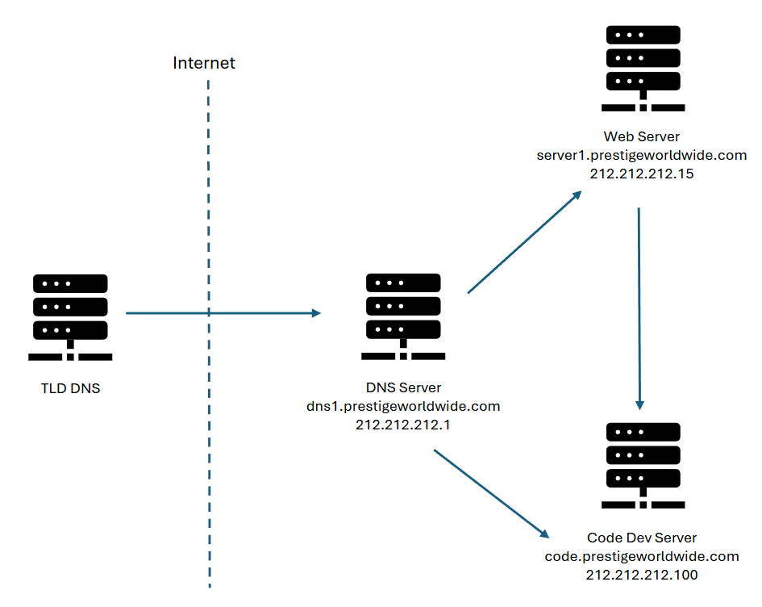

Jacob Stock
Gowtham Prasad
Gavin Money
Ricardo Rouco-Crenshaw
(prestigeworldwide.com, dns1.prestigeworldwide.com, NS)
(dns1.prestigeworldwide.com, 212.212.212.1, A)
Case 1:
(www.prestigeworldwide.com, server1.prestigeworldwide.com, CNAME)
(server1.prestigeworldwide.com, 212.212.212.15, A)
Case 2:
(code.prestigeworldwide.com, 212.212.212.100, A)

